Slide 1
Team Reggaetron Colin Swerdon, Ricardo Salcedo, Pavlo Manovi

Slide 2
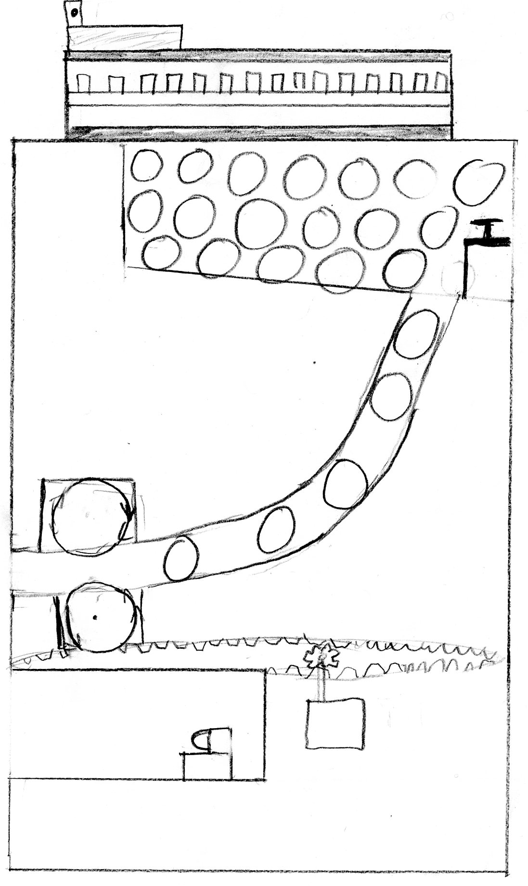
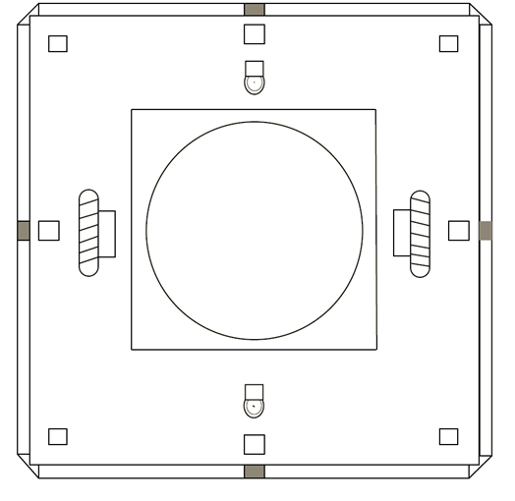
CPR

Slide 3
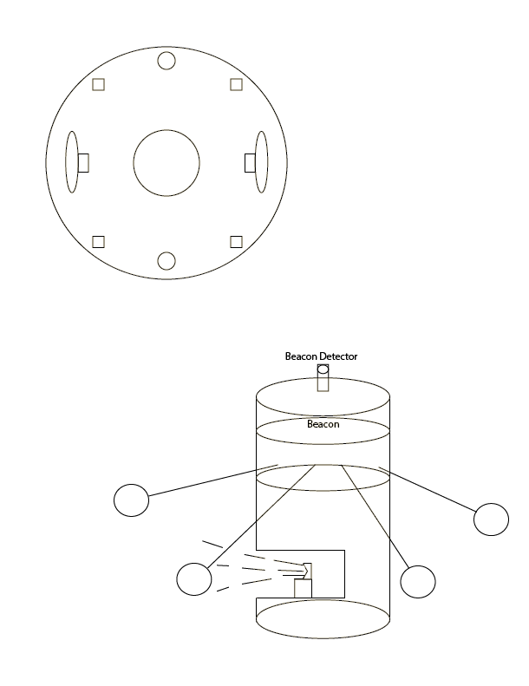
CPR

